Slide 1



XYRUS
YOUR FRIENDLY VIRUS

Slide 2
GENRE
Top-down Tactical Arcade.
Action-puzzle game.
TARGET AUDIENCE
Casual gamers who enjoy challenging yet approachable strategic gameplay.
Gamers involved in the medical field or bioscience.
Suitable for ages 10+ due to simple controls and a friendly aesthetic.

Slide 3
GAME CONCEPT
In Xyrus, Your Friendly Virus, players take control of Xyrus.
a lovable and misunderstood virus with a noble mission: to spread immunity.
Using strategic movement, infection abilities, and teleportation mechanics.
players must outsmart relentless white blood cells and infect most of the area and make it immune.

Slide 4
NOTABLE FEATURES
Infect areas to spread immunity while limiting Xyrus's movement.
Use a teleportation slime to escape danger and outmaneuver enemies.
Dynamic, increasing difficulty with additional white blood cells and may be environmental hazards.

Slide 5

CHARACTERS / ENTITIES
XYRUS
TELEPORTATION
slime
INFECTED
IMMUNE
WHITE BLOOD CELLS

Slide 6
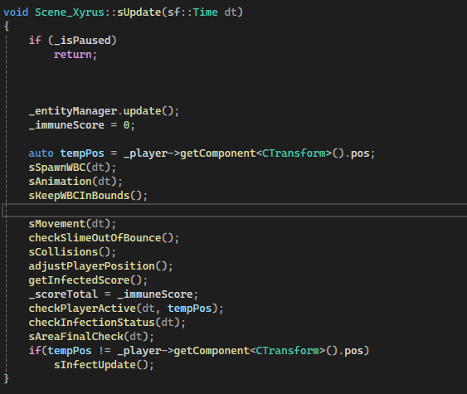
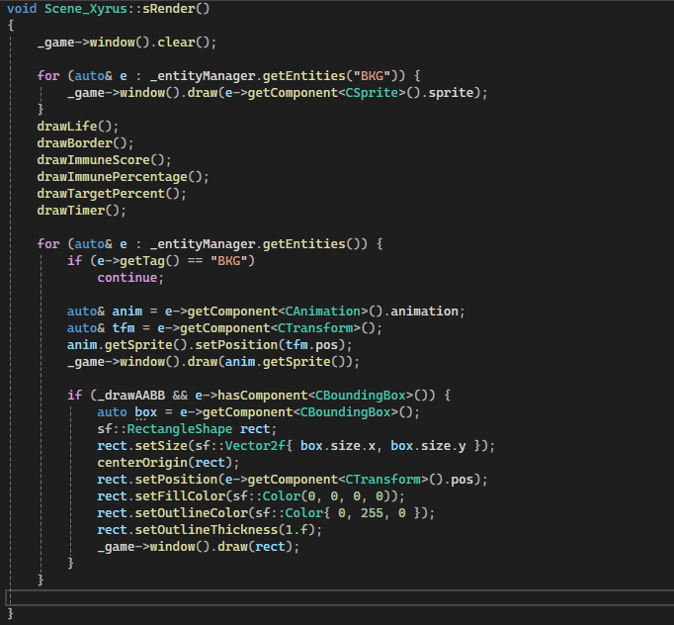
KEY CODE FLOW

Slide 7
THE GAME

Slide 8
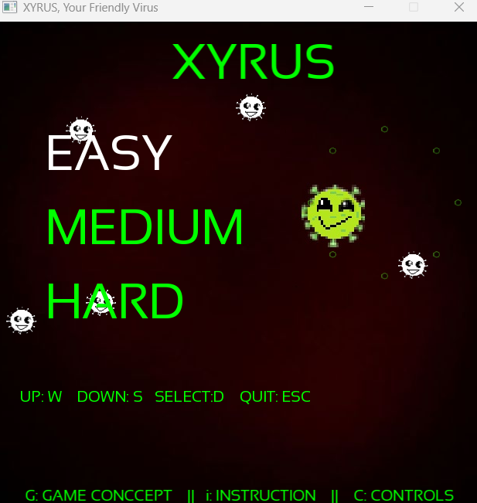
GAME MENU

Slide 9
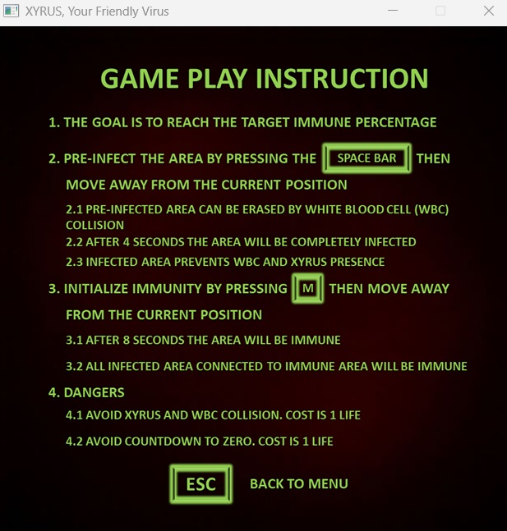
GAME PLAY

Slide 10
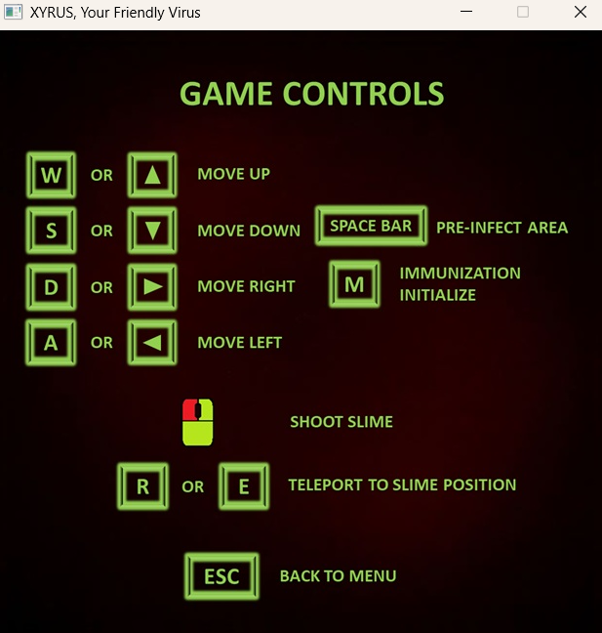
GAME CONTROLS

Slide 11
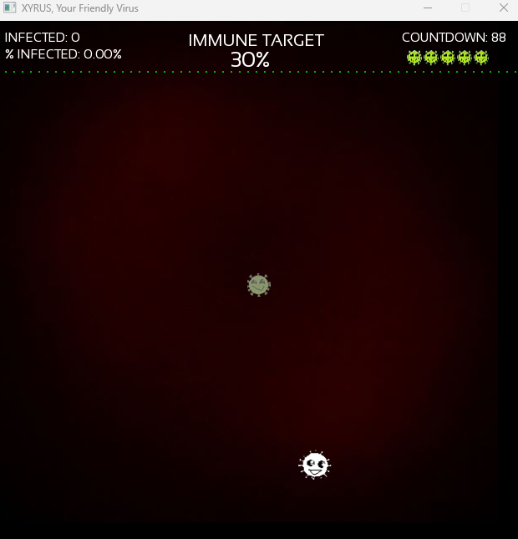
GAME OVERVIEW
INFECTED AREA COUNT
INFECTED VS TOTAL AREA PERCENTAGE
COUNTDOWN FOR EACH LIVES
TARGET IMMUNE AREA PERCENTAGE TO WIN
LIVES REMAINING
XYRUS INVISINBLE STATE
WHITE BLOOD CELL

Slide 12
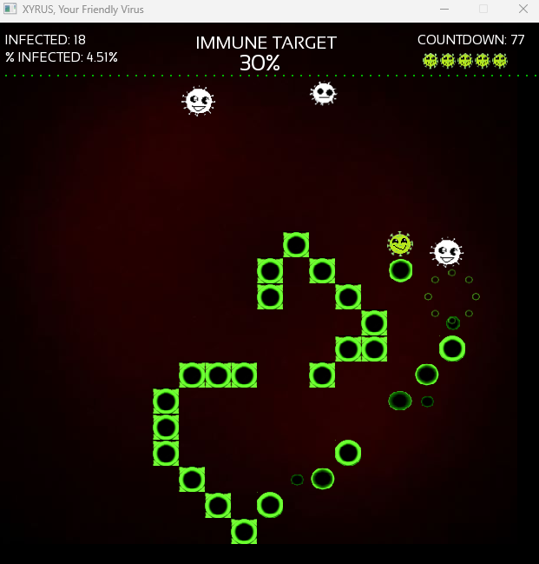
GAME OVERVIEW
XYRUS ON ACTIVE STATE
WHITE BLOOD CELLS
PRE-INFECTED AREA COLLIDES WITH WBC AND GETS DESTROYED
PRE-INFECTION SHRINKING AND GROWING FOR 4 SECS BEFORE INFECTED
INFECTED AREA

Slide 13
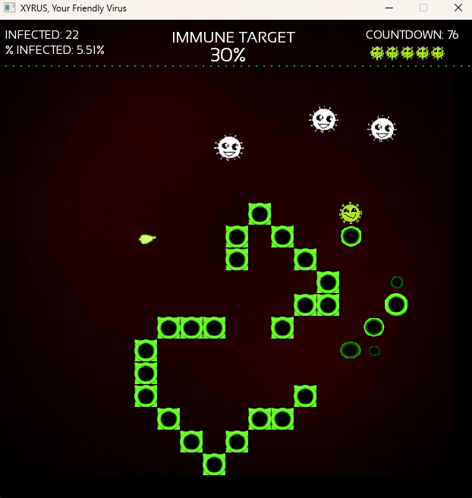
GAME OVERVIEW
TELEPORATION
SLIME

Slide 14
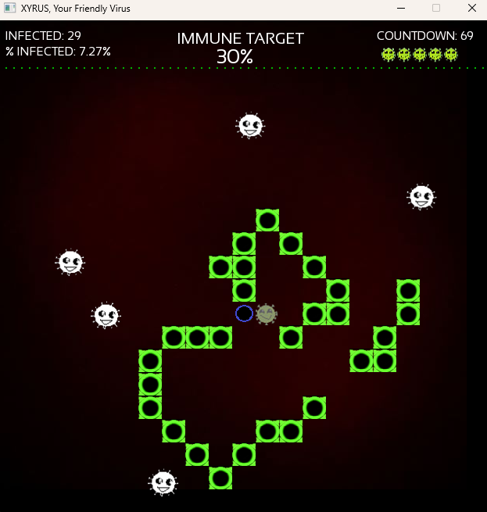
GAME OVERVIEW
INITIAL IMMUNISATION STARTS
SHRINKING AND GROWING FOR 8 SECS BEFORE IMMUNE COUNT

Slide 15
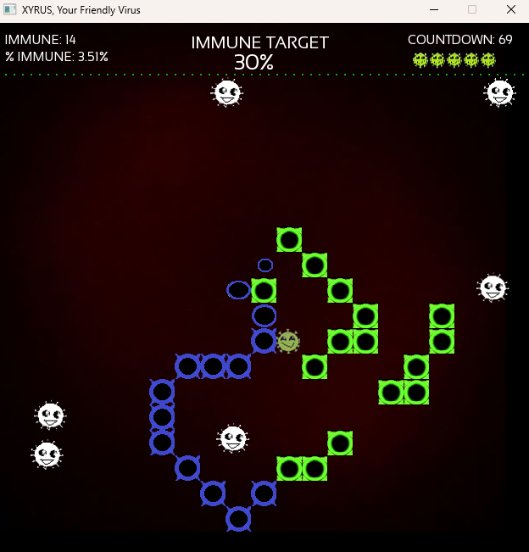
GAME OVERVIEW
START COUNTING AFTER INITIAL IMMUNISATION
IMMUNE AREA

Slide 16
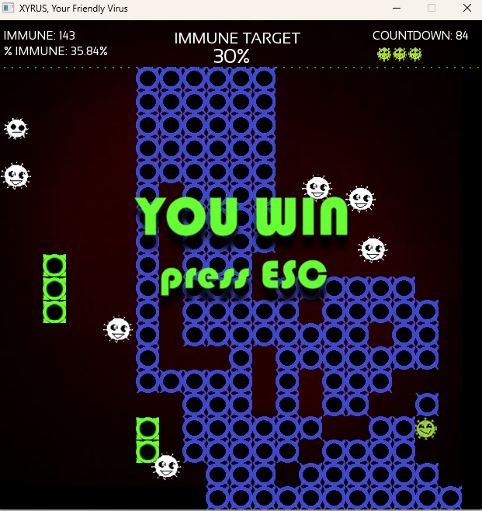
GAME OVERVIEW
IF IMMUNE % IS GREATER THAN IMMUNE TARGET, PLAYER WIN

Slide 17
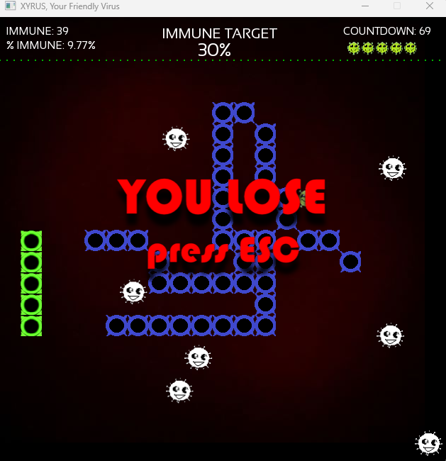
GAME OVERVIEW
IF IMMUNE % IS LESS THAN IMMUNE TARGET, PLAYER LOSE

Slide 18
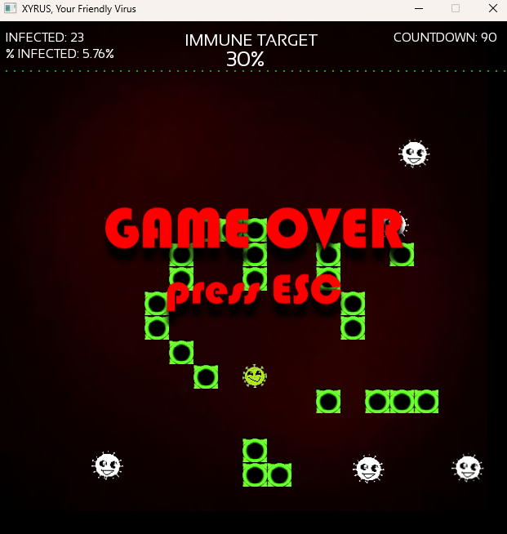
GAME OVERVIEW
IF NOT LIFE LEFT,
GAME OVER

